Slide 1
Email Marketing Data Analysis Project - Unsubscribers
Cameron Ellis

Slide 2
Introduction
Email marketing is an important part of ABC company’s community outreach
An unsubscribe rate to these emails could negatively affect the company’s outreach and sales
If there are underlying reasons for an undesirable rate, it is in the company’s best interest to pursue these reasons and rectify the issue(s)

Slide 3
Objectives:
Perform Exploratory Data Analysis related to ABC company’s email engagement as it relates to users unsubscribing
Diagnose potential causes to high rates of unsubscribing on a macro and micro level
Recommend actionable solutions, acting as a member of ABC company’s marketing team

Slide 4
Dataset:
email_marketing.db public data provided on LinkedIn by Mary Knoeferl
5 Tables of data:
Campaign_Performance (shows total emails sent and unsubscribed to by different campaigns)
Campaign (shows campaign category)
Email_Engagement (shows email data at the user level)
Unsubscribes (gives unsubscribe date and reason for unsubscribing by user)
Users (gives user signup date and region/location of user)

Slide 5
Steps Taken:
Dataset exported locally to Desktop
Used Sqlite DB browser to execute initial Exploratory Data Analysis
Further EDA and visualization done using Tableau Public
PPT used to summarize analysis and visualizations

Slide 6
Overall Unsubscribe Rate:
Category | Number
Total Emails | 30,000
Unsubscribes | 1,516
Unsubscribe Rate: | 5.053%
According to Agency Analytics Website, even a 2-3% Unsubscribe Rate is undesirable, implying potential issues with the emails being sent out. This is cause for concern

Slide 7
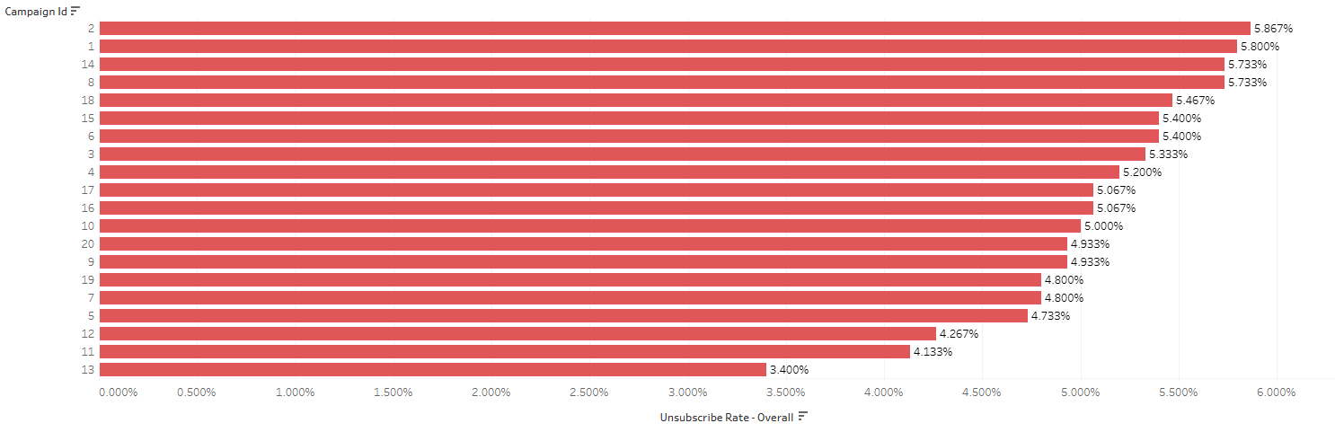
Looking Closer: Unsubscribe Rate by Campaign
Even the lowest unsubscribe rate is above 3%, but there are clearly some campaigns helping our rate and some that our hurting our rate, which should be looked into further:

Slide 8
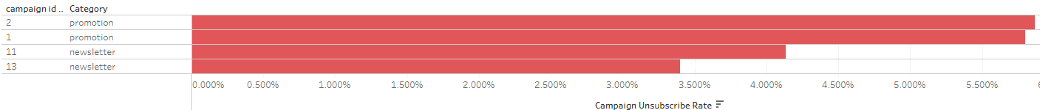
Looking Closer: Unsubscribe Rate by Campaign/Category
Looking at the top two and bottom two campaigns by unsubscribe rate (2 and 1 are highest, 11 and 13 are lowest respectively), we can see that they are both isolated into two categories: promotion and newsletter:
The implication is that newsletter campaigns may be doing something right, and promotional campaigns may be doing something wrong

Slide 9
How long does it take the average user to unsubscribe? Median?
Calculation | # of Days
Average Unsubscribe Time | 234.98
Median Unsubscribe Time | 221
The average being higher than the median indicates data is positively skewed, which implies more lower value points than higher value points. Is there a trend?

Slide 10
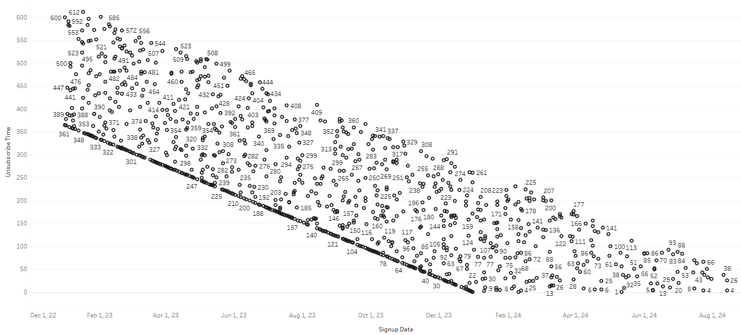
There is a trend! In general, users who have signed up more recently (newer users) are unsubscribing faster than older users

Slide 11
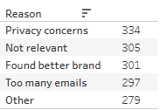
Why did people say they were unsubscribing?
Do these reasons differ by campaign Category?

Slide 12
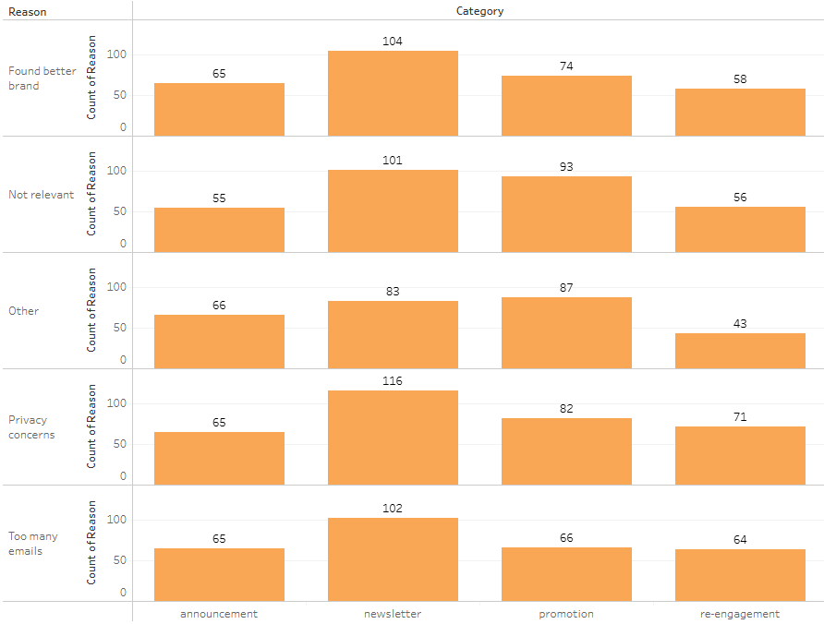
There is a difference. “Other” and “not relevant” are concerns for promotional campaigns. “Privacy concerns” for Re-engagement and Newsletter is another.

Slide 13
Summary of Findings
5.05% Unsubscribe Rate
Campaigns 1 and 2 (both promotions) are the campaigns most needing improvement, while Campaigns 11 and 13 (both newsletters) are the campaigns setting the expectation, although unsubscribe rates are still concerning across all campaigns, with the lowest rate being 3.4%
Average Unsubscribe time sits at roughly 235 days, while median sits at 221
In general, users who have signed up more recently to our emails are unsubscribing at a quicker rate than older users
Privacy and Relevancy are the primary concerns for unsubscribing, while Other is the lowest concern and “Too many emails” is the lowest specific concern

Slide 14
Actionable Recommendations:
#1: Promotional Campaigns
The most popular unsubscribe reason for the promotions category is “Not Relevant.” “Too many emails” reason for unsubscribing is the lowest reason for unsubscribing from promotional campaigns.
Recommendation: Complete a review of future outgoing promotional emails to identify/rectify the relevance of said emails to their corresponding campaign. In the next promotional campaigns, increase the volume of emails.
“Other” is the second most popular unsubscribe reason for the promotional category, which indicates that there is an issue with emails sent that we haven’t been able to ascertain.
Recommendation: When users who subscribed to a promotional campaign unsubscribe and list “other” as their reason, add in a fill in the blank box so we can get a better picture of their reason for unsubscribing.

Slide 15
Actionable Recommendations: #2:
New users unsubscribing faster
There is a trend of new subscribers unsubscribing at a faster rate than older subscribers. Has there been a change on ABC company’s side of things with correlation to the faster unsubscribe rate?
Recommendation: I would recommend that one of our marketing teams research whether there have been changes in the types of emails sent or clients/campaigns reached out to or accepted regarding new subscribers over the course of the dates of the dataset.
If there is a correlation we can investigate causation and change our approach if needed.
It is possible that there hasn’t been a distinguishable difference in types of emails sent or clients/campaigns reached out to or accepted. If so, we can rule this out as a possibility, but it’s worth ruling out.

Slide 16
Actionable Recommendation #3: Privacy
“Privacy concerns” is ABC company’s most frequent reason cited for unsubscribing.
Most notably, privacy is the most frequent reason cited for Newsletter and Re-engagement categories.
The implication is that our company is either not protecting user privacy or we aren’t being clear about how we are. In terms of re-engagement category, it’s also possible that users didn’t know or remember that we still had their information, even if they did sign up.
Recommendation: Every email sent needs to have a clear link to our company’s privacy policy. This should be in larger characters towards the beginning of the email.

Slide 17
Conclusion
Based on our analysis, ABC company has a relatively high unsubscribe rate due to primary factors including relevance and privacy concerns, as well as some unknowns that require further research
New users are generally unsubscribing at a faster rate than older users, which should be a major cause for concern as (more than just an unsubscribe rate) this reduces the volume of email marketing emails that can be seen by more users in general.
Privacy, especially in the digital age, is a growing concern and ABC company should do all it can to be a solution rather than a problem as it relates to this concern.

